Slide 1


Health Monitoring & Location
Tracking System

Slide 2

Team Members
Member 1
Member 2
Member 3
AMBIKA
ROLL_No: 2002220310004
Rahul Raj
ROLL_No: 2002220310016
Raju Kumar
ROLL_No: 2002220310017
Mentor
Mr. Agha A. Husain
Asst. Prof : ECE

Slide 3
Table of Content
1. Project Title
2. Introduction
Problem Definition.
Objectives
Hardware Components
Node Description
3. Software Technology and Features:
Emotion detection using Face Expressions
Extra Libraries And QnA

Slide 4
Topics Covered In Previous Presentations :
Presentation -1
Project idea Submission
Presentation -2
Basic Introduction
Software & Hardware Selections
Task Scheduling
Presentation -3
Detailed Introduction of Components
Introduction of Software Tools & Technologies
Presentation -4
Discussions of Required Modifications in Project
Work load and Project Status Update

Slide 5
Introduction
Project Overview
Develop an integrated health monitoring and location tracking system for soldiers.
Use biomedical sensors, GPS technology, and advanced communication modules.
Collect and analyze real-time health data to enhance soldier safety in battlefield scenarios.
Use machine learning algorithms for data clustering to aid control units in making timely decisions.
Provide a robust, lightweight solution for improving the overall coordination and responsiveness of military operations.
Aim to develop a real-time health monitoring and location tracking system for soldiers in battlefield scenarios.
Hardware overview, including Arduino MEGA, various sensors (heart rate, temperature, etc.), GPS module, ZigBee, LoRaWAN, and more.
Enhanced safety for soldiers through continuous health monitoring.
Improved communication and coordination between soldiers and control units.

Slide 6




Objectives
1. Enhanced Soldier Safety
2. Real-time Location Tracking
3. Communication Improvement
Ensure the safety of soldiers in the battlefield through real-time monitoring of their health status and environmental conditions.
To address potential health risks.
Implement a(GPS) module to track the real-time location of soldiers.
Establish wireless communication networks among soldiers using ZigBee modules.
Enable seamless data transmission from soldiers to the control unit

Slide 7


Applications
Blood Pressure Monitoring
Body Temperature Monitoring
Electrocardiogram Monitoring
Real time Location Tracking
Real time Video Capturing
Bomb Detector

Slide 8
Major Hardware Components
Arduino MEGA 2560
Heartbeat Sensor
Temperature Sensor and Humidity Sensor (DHT11)
Accelerometer (ADXL335)
Ethernet Shield (W5100)
GPS Module (NEO-6M)
LoRaWAN Module
ECG Module (AD8232 i.e. Electro-Cardiogram)

Slide 9
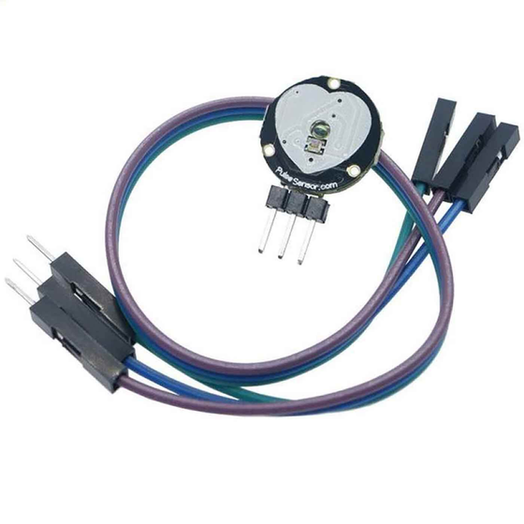
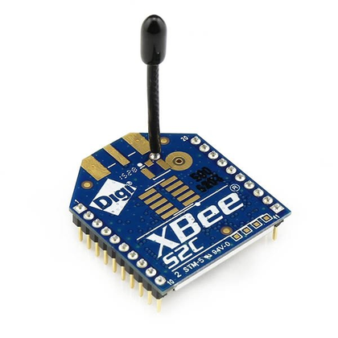
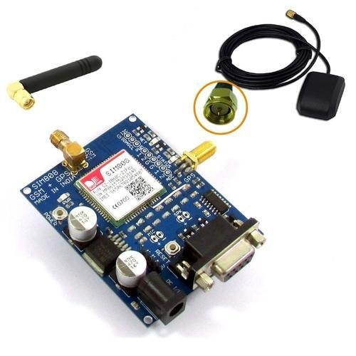
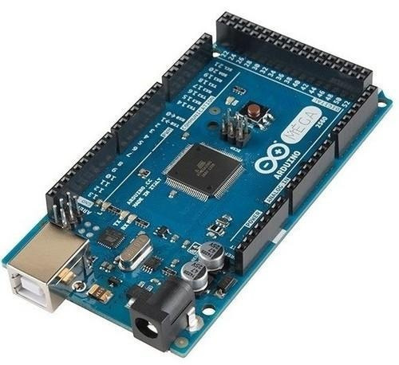
Health Monitoring: Heartbeat sensor for real-time pulse tracking and temperature sensor for environmental conditions.
Motion Detection: Accelerometer provides insights into soldier movement and vibrations, aiding in situational awareness.
04
Wireless Communication: ZigBee enables efficient communication among soldiers, promoting real-time data exchange.
Long-Range Connectivity: LoRaWAN ensures data transmission between squadron leader and control unit in high-altitude warzones.
03
Proposed System Overview
02
Real-time Location Tracking: NEO-6M GPS module ensures accurate and timely location information.
Navigation Support: Facilitates precise navigation for soldiers and aids control unit in coordinating operations.
Global Coverage: Enables tracking in diverse geographical terrains, contributing to mission success.
01
Microcontroller Core: Heart of the system, facilitating control, processing, and communication.
Versatile I/O Ports: Offers extensive input/output options for seamless integration with various sensors and modules.
Programmability: Allows customization and adaptability to evolving mission requirements.

Slide 10
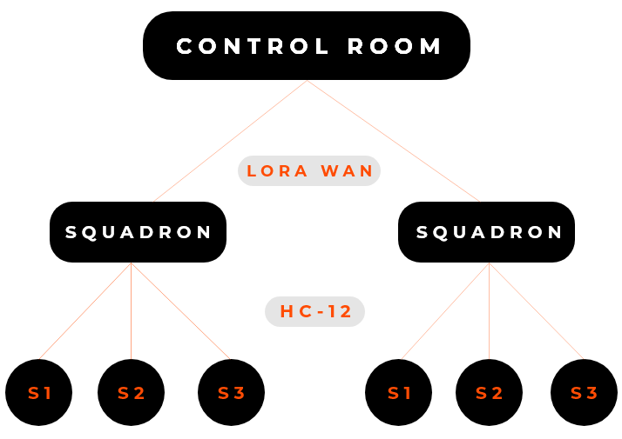
The hierarchy of obtaining data from the soldier is divided into three segments:
Soldier's Node - Level 1
Squadron's Node/ GROUP LEAD - Level 2
Control unit Node - Level 3

Slide 11
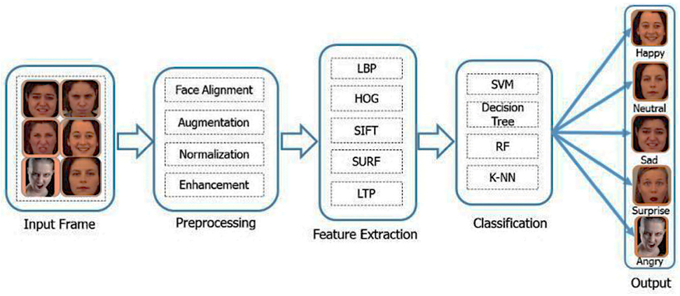
Real Time Video Capturing
Control unit Node - Level 3:
By the use of Facial Recognition Technology at the Control Unit Level to identify the identity of the soldiers , school going student And also with the use of face expression we define their emotions like happy, sad, Angry and many more…..

Slide 12
Software Technology
Arduino IDE, Blynk IOT :
Purpose: Programming the Arduino MEGA 2560 microcontroller.
Machine Learning Technology :
Supervised Learning
Unsupervised Learning
MACHINE LEARNING ALGORITHM (PYTHON):
Role: Utilized Python algorithm aids in grouping soldier data based on health conditions for further insights.

Slide 13
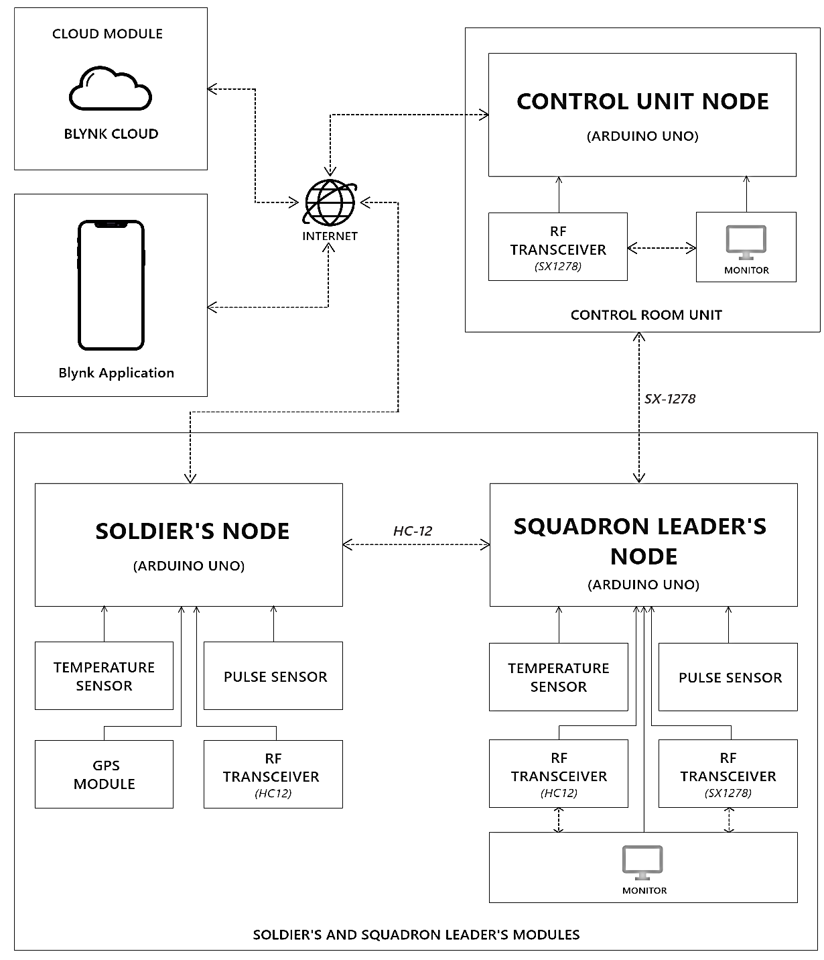
The block diagram below explains how the nodes and all the internal sensors are connected.

Slide 14
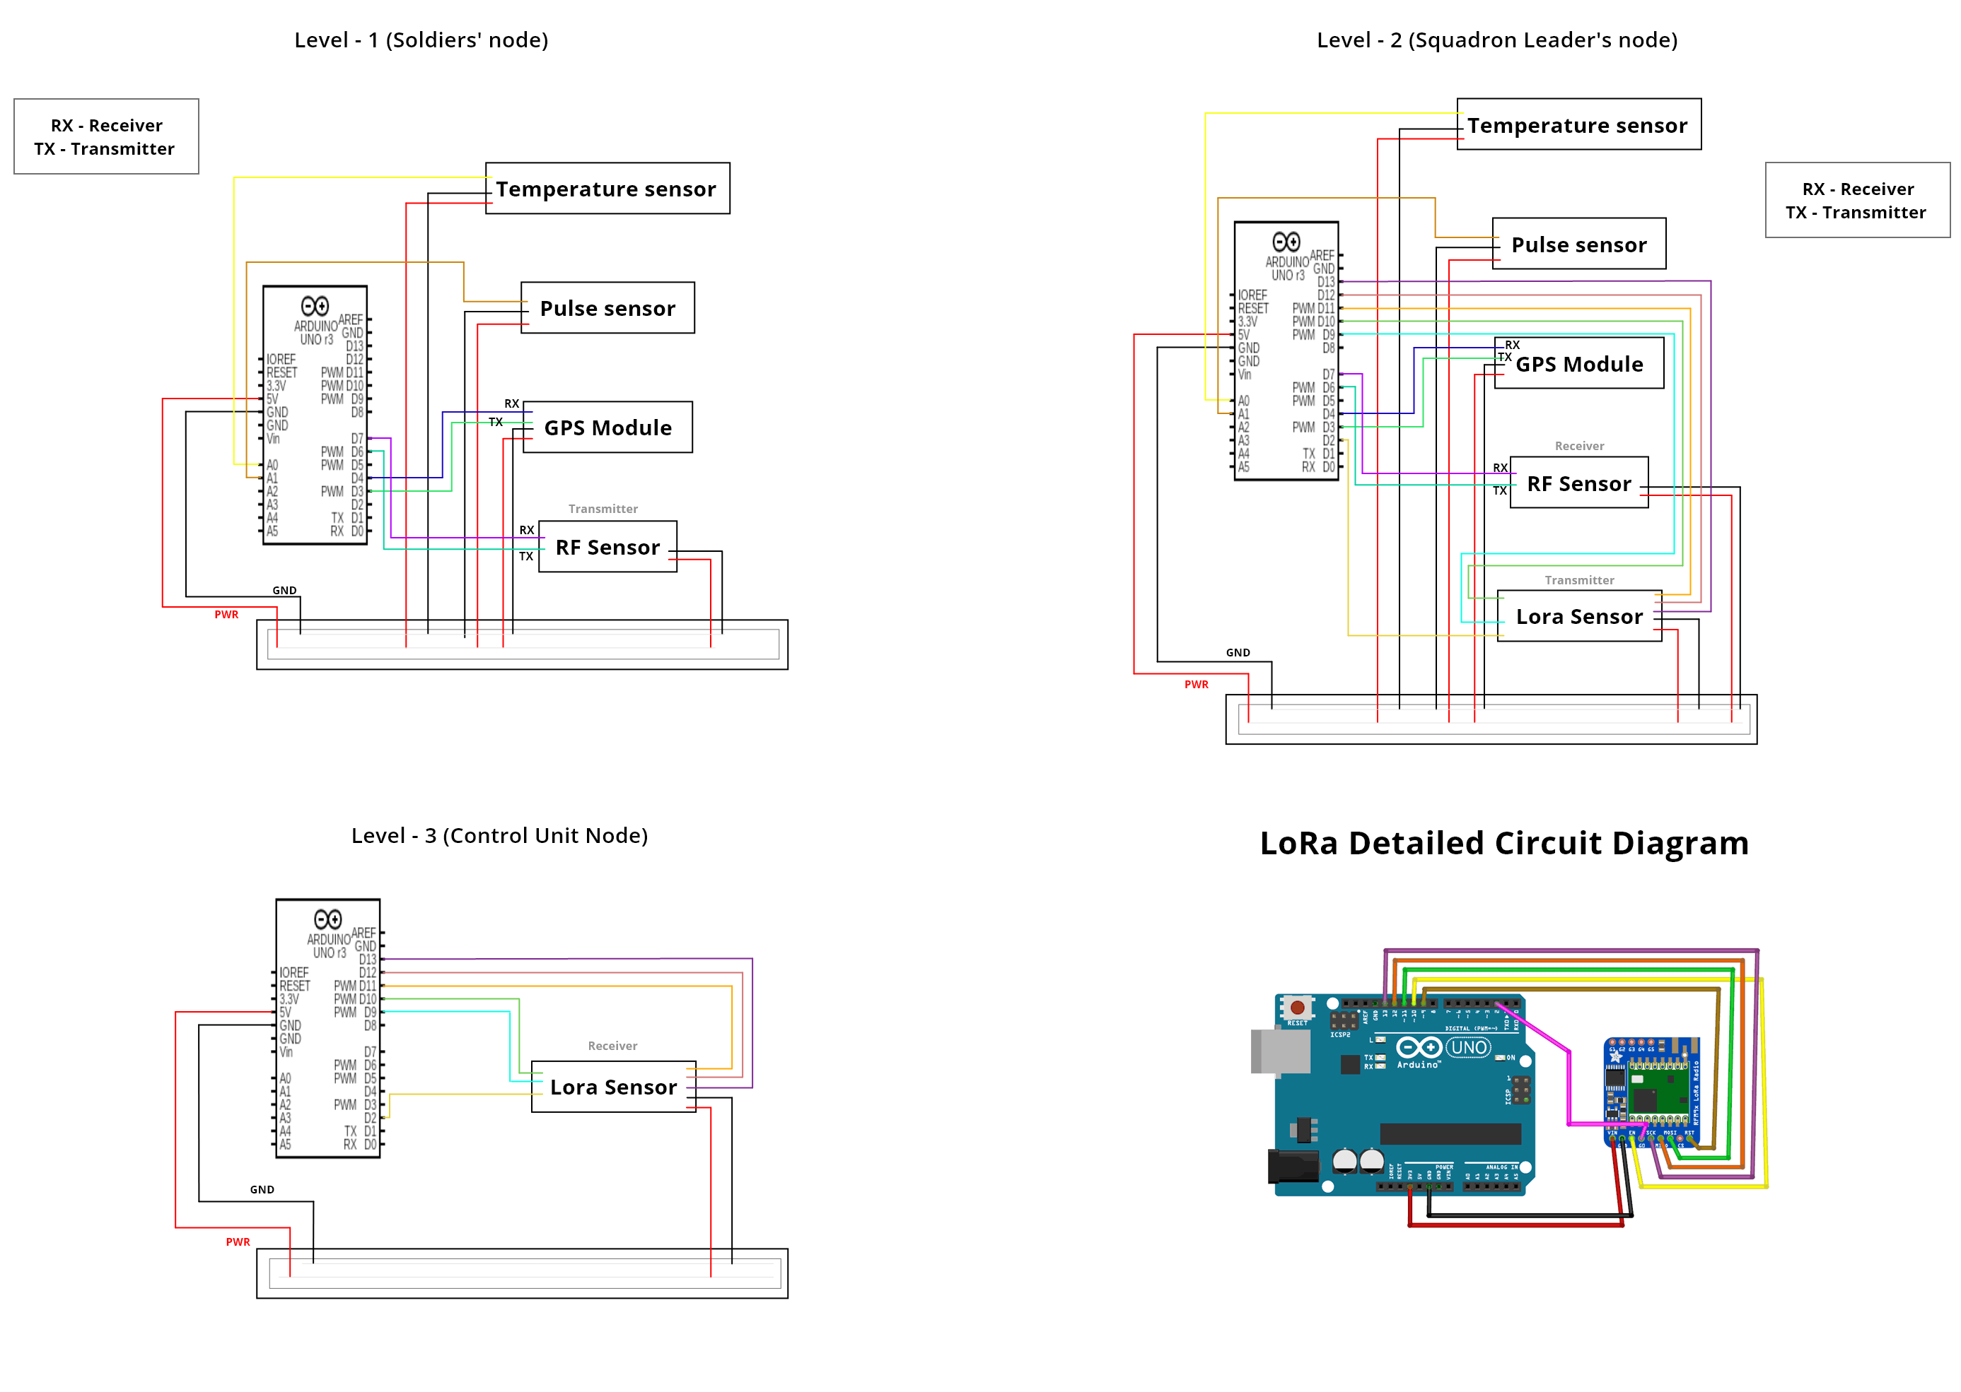
Circuit Diagram for the project

Slide 15
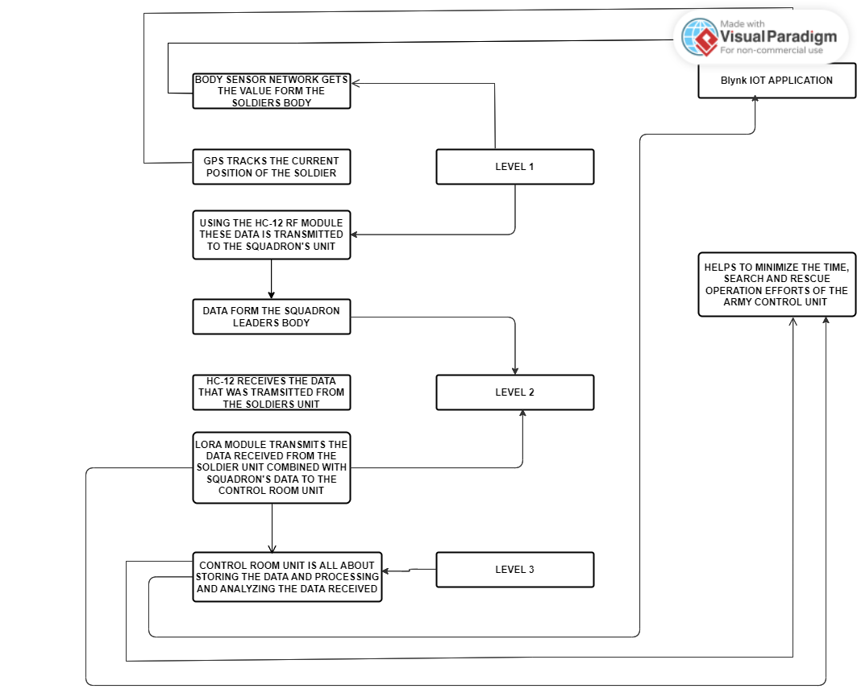
FLOW CHART

Slide 16
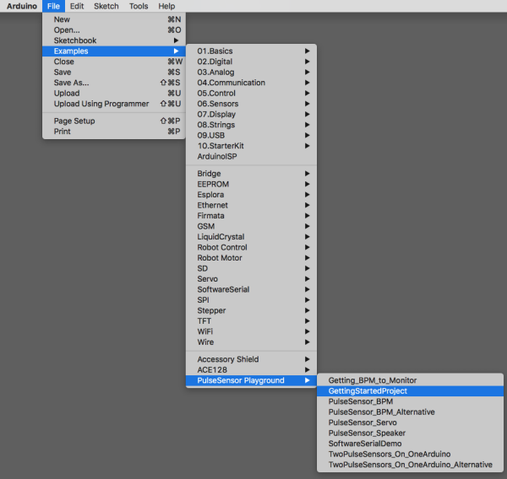
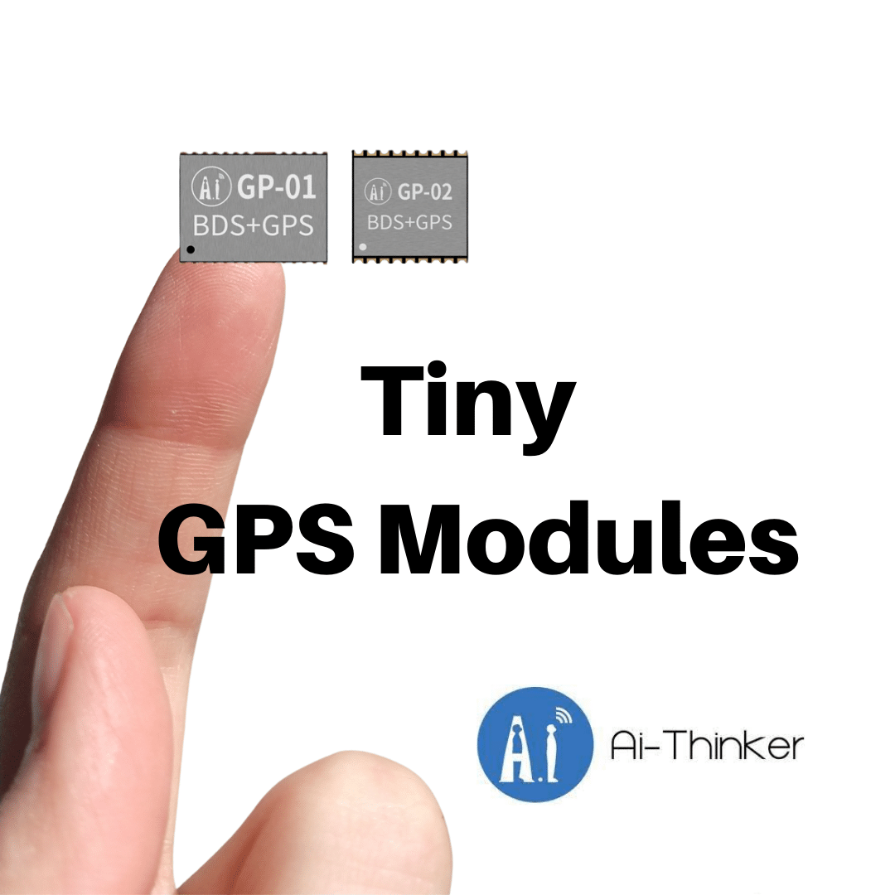
Extra libraries
TinyGPS++
PulseSensorPlayground
LoRa

Slide 17
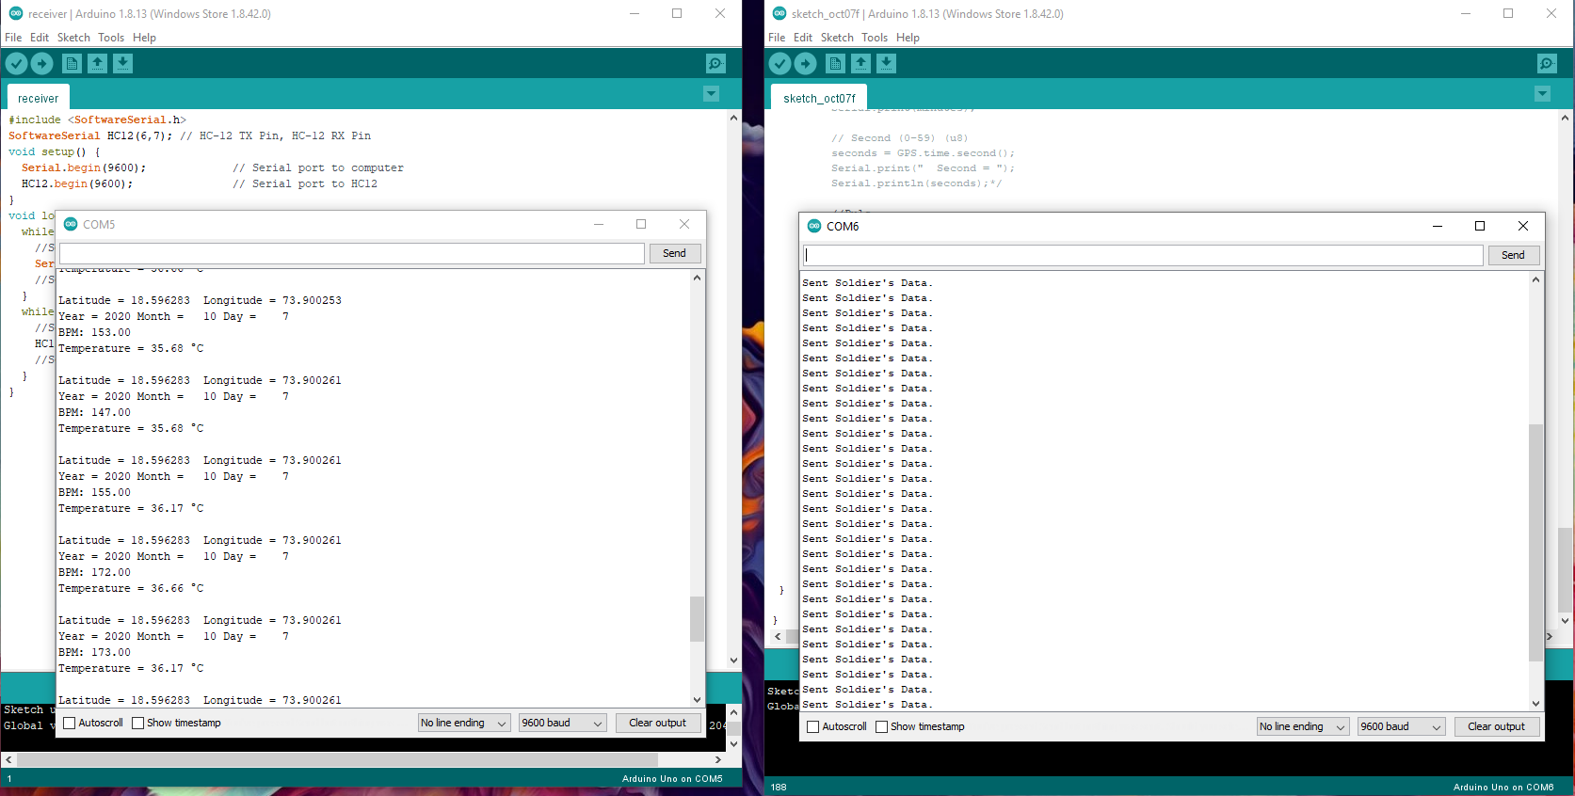
Level 1- Integration

Slide 18
Level 1- Integration

Slide 19
Level 1- Integration

Slide 20
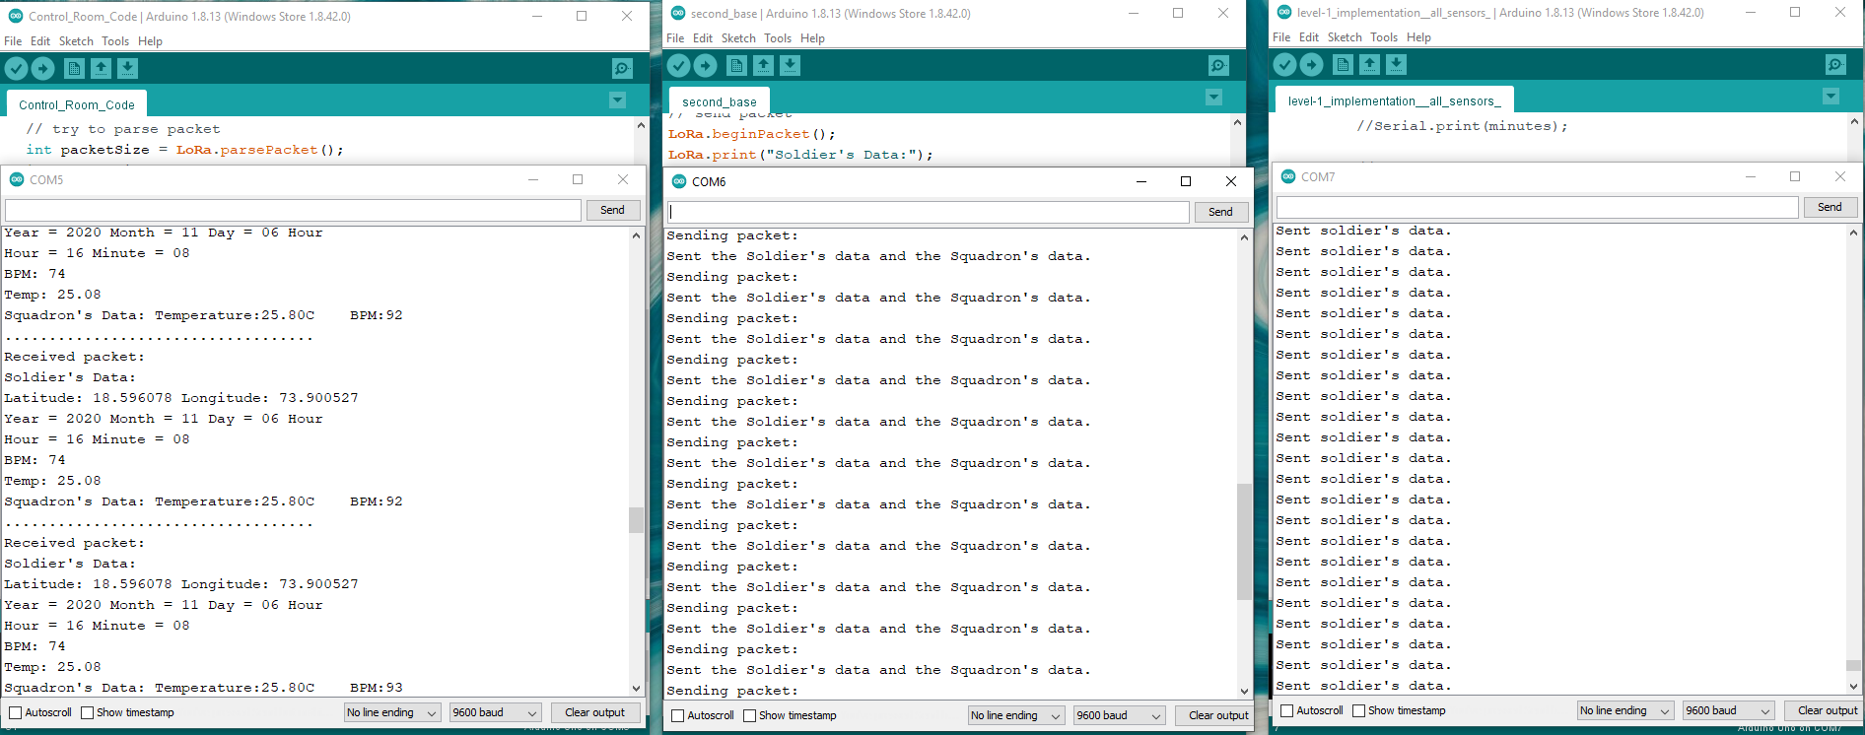
Final Implementation

Slide 21
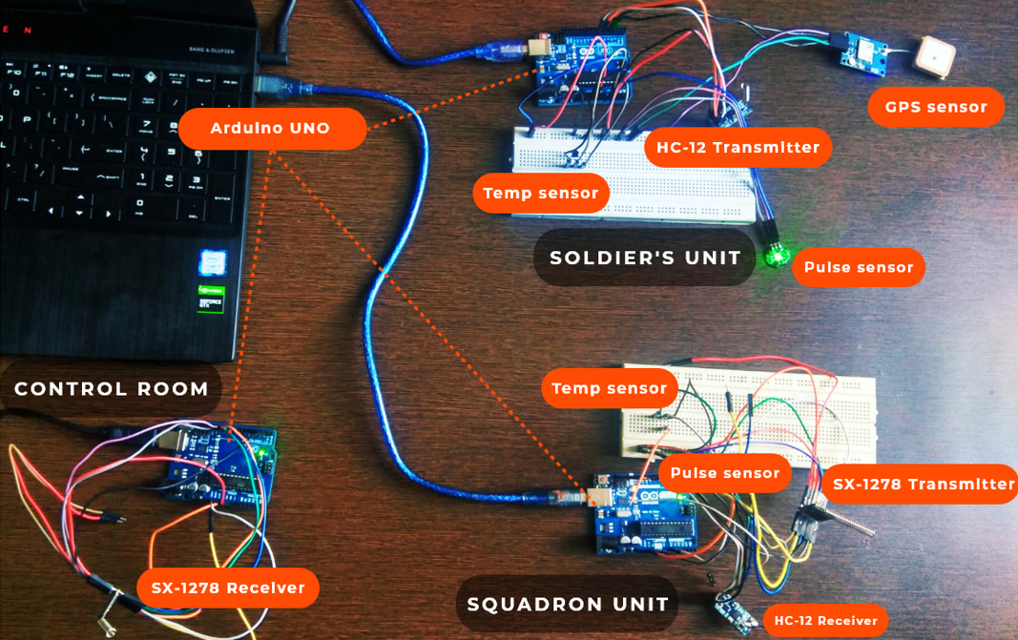
Proto Type Image

Slide 22
References
Gondalia, A., Dixit, D., Parashar, S., Raghava, V., Sengupta, A., & Sarobin, V. R. (2018). IoT-based healthcare monitoring system for war soldiers using machine learning. Procedia computer science, 133, 1005-1013.
Philip, J., Gandhimathi, S. K., Chalichalamala, S., Karnam, B., Chandanapalli, S. B., & Chennupalli, S. (2023). Smart Health Monitoring Using Deep Learning and Artificial Intelligence. Revue d'Intelligence Artificielle, 37(2).
Zhu, Y. (2022). Smart Remote Personal Health Monitoring System: Addressing Challenges of Missing and Conflicting Data (Doctoral dissertation, Massachusetts Institute of Technology).Chicago
Alazzam, M. B., Alassery, F., & Almulihi, A. (2021). A novel smart healthcare monitoring system using machine learning and the Internet of Things. Wireless Communications and Mobile Computing, 2021, 1-7.
Davoudi, A., Malhotra, K. R., Shickel, B., Siegel, S., Williams, S., Ruppert, M., ... & Rashidi, P. (2019). Intelligent ICU for autonomous patient monitoring using pervasive sensing and deep learning. Scientific reports, 9(1), 8020.
Islam, M. M., Rahaman, A., & Islam, M. R. (2020). Development of smart healthcare monitoring system in IoT environment. SN computer science, 1, 1-11.

Slide 23
THANK YOU

Slide 24



PROJECT TIMELINE
 | WEEK 1-2 | WEEK 3-5 | WEEK 6-8 | WEEK 9-12
TASK NAME | project scope | Begin research on mL algorithms | Initial prototype | Implement ZigBee with GPS module
TASK NAME | Research on Existing system | finalize hardware component | data collection for ML algorithm | Cloud Integration and Data Analysis
TASK NAME | Develop a detailed project plan | plan for software development and integration | Integrate biomedical sensors | Documentation, Presentation & final testing

Slide 25
Challenges
Bias and Fairness: Emotion detection models may exhibit bias or unfairness due to skewed training data, cultural stereotypes, or algorithmic biases. Ensuring fairness and mitigating biases in emotion detection systems is crucial to avoid perpetuating societal inequalities and discrimination.
Data Quality and Quantity: Obtaining high-quality, labeled datasets for training emotion detection models can be challenging due to the subjective nature of emotion labeling and the need for large-scale, diverse datasets to capture the variability of emotional expressions.
Cross-Modal Integration: Integrating information from multiple modalities (text, speech, facial expressions, physiological signals) poses a challenge due to differences in data formats, feature representations, and temporal dynamics, requiring sophisticated fusion techniques and model architectures.

Slide 26
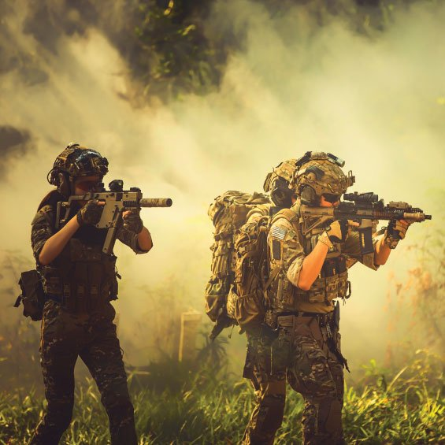

Conclusion
The "Real-time Health Monitoring and Location Tracking System for Soldiers" stands as a testament to the commitment to advancing the safety, effectiveness, and coordination of military operations through cutting-edge technology. This project not only addresses current challenges but also paves the way for a future where the well-being of soldiers remains at the forefront of technological innovation.

Slide 27

Microcontroller Core: Heart of the system, facilitating control, processing, and communication.
Versatile I/O Ports: Offers extensive input/output options for seamless integration with various sensors and modules.
Programmability: Allows customization and adaptability to evolving mission requirements.
Real-time Location Tracking: NEO-6M GPS module ensures accurate and timely location information.
Navigation Support: Facilitates precise navigation for soldiers and aids control unit in coordinating operations.
Global Coverage: Enables tracking in diverse geographical terrains, contributing to mission success.
Health Monitoring: Heartbeat sensor for real-time pulse tracking and temperature sensor for environmental conditions.
Motion Detection: Accelerometer provides insights into soldier movement and vibrations, aiding in situational awareness.
Wireless Communication: ZigBee enables efficient communication among soldiers, promoting real-time data exchange.
Long-Range Connectivity: LoRaWAN ensures data transmission between squadron leader and control unit in high-altitude warzones.

